Slide 1
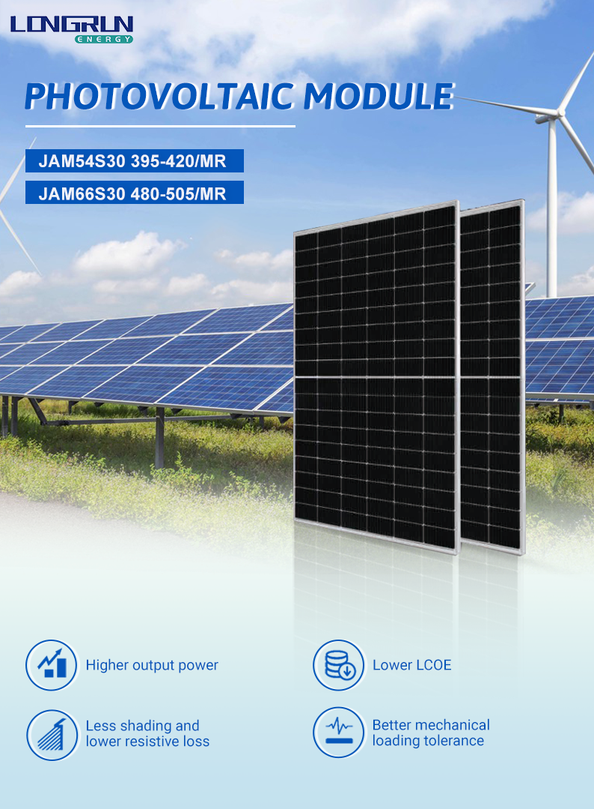

Slide 2
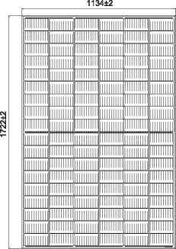
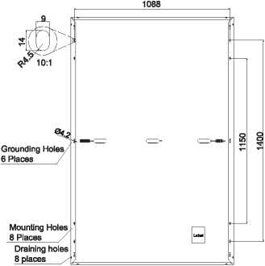



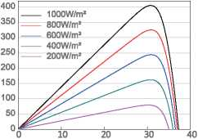
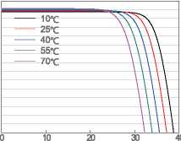
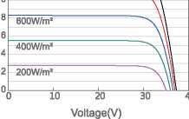
JAM54S30 395-420/MR
MECHANICAL DIAGRAMS
SPECIFICATIONS
Series
30±1
Cell | Mono
Weight | 21.5kg±3%
Dimensions | 1722±2mmxll 34±2mm*30±1 mm
Cable Cross Section Size | 4mm² (IEC) , 12AWG(UL)
No. of cells | 108(6x18)
Junction Box | IP68, 3 diodes
Connector | QC4.10(1000V) QC 4.10-35(1500V)
Cable Length (Including Connector) | Portrait: 300mm(+)/400mm(-); Landscape: 1200mm(+)/1200mm(-)
Packaging Configuration | 36pcs/Pallet, 936pcs/40ft Container
Remark: customized frame color and cable length available upon request
ELECTRICAL PARAMETERS AT STC
TYPE | JAM54S30 -395/MR | JAM54S30 -400/MR | JAM54S30 -405/MR | JAM54S30 -410/MR | JAM54S30 -415/MR | JAM54S30 -420/MR
Rated Maximum Power(Pmax) [W] | 395 | 400 | 405 | 410 | 415 | 420
Open Circuit Voltage(Voc) [V] | 36.98 | 37.07 | 37.23 | 37.32 | 37.45 | 37.58
Maximum Power Voltage(Vmp) [V] | 30.84 | 31.01 | 31.21 | 31.45 | 31.61 | 31.80
Short Circuit Current(lsc) [A] | 13.70 | 13.79 | 13.87 | 13.95 | 14.02 | 14.10
Maximum Power Current(lmp) [A] | 12.81 | 12.90 | 12.98 | 13.04 | 13.13 | 13.21
Module Efficiency [%] | 20.2 | 20.5 | 20.7 | 21.0 | 21.3 | 21.5
Power Tolerance |  |  | 0~+5W
Temperature Coefficient of Isc(ajsc) |  |  | +0.045%°C
Temperature Coeificient of Vbc(3_Voc) |  |  | -0.275%/°C
Temperature Coefficient of Pmax(Y_Pmp) |  |  | -0.350%/°C
STC |  | Irradiance 1000W/m², cell temperature 25°C, AM1.5G
Remark: Electrical data in this catalog do not refer to a single module and they are not part of the offer.They only serve for comparison among different module types.
ELECTRICAL PARAMETERS AT NOCT |  |  |  |  |  |  | OPERATING CONDITIONS
TYPE | JAM54S30 -395/MR | JAM54S30 -400/MR | JAM54S30 ■405/MR | JAM54S30 -410/MR | JAM54S30 -415/MR | JAM54S30 -420/MR | Maximum System Voltage | 1000V/1500V DC
Rated Max Power(Pmax) [W] | 298 | 302 | 306 | 310 | 314 | 318 | Operating Temperature | -40C-+85C
Open Circuit Voltage(Voc) [V] | 34.75 | 34.88 | 35.12 | 35.23 | 35.37 | 35.50 | Maximum Series Fuse Rating | 25A
Max Power Voltage(Vmp) [V] | 29.08 | 29.26 | 29.47 | 29.72 | 29.89 | 30.09 | Maximum Static Load,Front Maximum Static Load,Back | 5400Pa(112lb/ft²) 2400Pa(50lb/ft²)
Short Circuit Current(lsc) [A] | 10.96 | 11.03 | 11.10 | 11.16 | 11.22 | 11.29 | NOCT | 45±2C
Max Power Current(lmp) [A] | 10.25 | 10.32 | 10.38 | 10.43 | 10.50 | 10.57 | Safety Class | Class II
NOCT | Irradiance 800W/m², ambient temperature 20°C,wind speed 1m/s, AM1.5G |  |  |  |  |  | Fire Performance | UL Type 1
CHARACTERISTICS
Current-Voltage Curve JAM54S30-405/MR
Power-Voltage Curve JAM54S30-405/MR
14
4 2 0
12
800W/m-
wolMod
Current-Voltage Curve JAM54S30-405/MR
cajjno
6
VoltagefV)
VoltagefV)

Slide 3
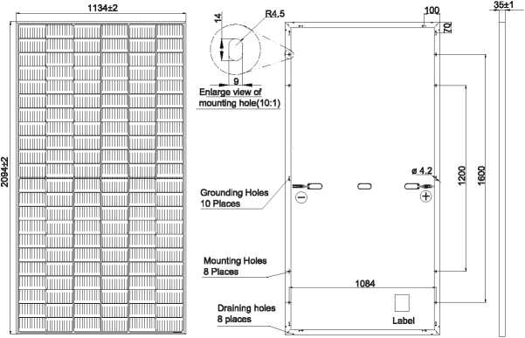

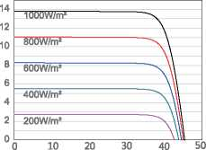
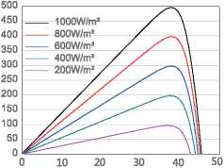
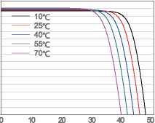
JAM66S30 480-505/MR
Series
MECHANICAL DIAGRAMS
SPECIFICATIONS
Cell | Mono
Weight | 26.3kg±3%
Dimensions | 2094±2mmx1134±2mm*35±1 mm
Cable Cross Section Size | 4mm² (IEC) , 12AWG(UL)
No. of cells | 132(6x22)
Junction Box | IP68, 3 diodes
Connector | QC4.10(1000V) QC 4.10-35(1500V)
Cable Length (Including Connector) | Portrait: 300mm(+)/400mm(-); Landscape: 1200mm(+)/1200mm(-)
Packaging Configuration | 31pcs/Pallet, 682pcs/40ft Container
Remark: customized frame color and cable length available upon request
ELECTRICAL PARAMETERS AT STC
TYPE | JAM66S30 -480/MR |  | JAM66S30 -485/MR | JAM66S30 -490/MR |  | JAM66S30 -495/MR | JAM66S30 -500/MR | JAM66S30 -505/MR
Rated Maximum Power(Pmax) [W] | 480 |  | 485 |  | 490 | 495 | 500 | 505
Open Circuit Voltage(Voc) [V] | 45.07 |  | 45.20 |  | 45.33 | 45.46 | 45.59 | 45.72
Maximum Power Voltage(Vmp) [V] | 37.62 |  | 37.81 |  | 37.99 | 38.17 | 38.35 | 38.53
Short Circuit Current(lsc) [A] | 13.65 |  | 13.72 |  | 13.79 | 13.86 | 13.93 | 14.00
Maximum Power Current(lmp) [A] | 12.76 |  | 12.83 |  | 12.90 | 12.97 | 13.04 | 13.11
Module Efficiency [%] | 20.2 |  | 20.4 |  | 20.6 | 20.8 | 21.1 | 21.3
Power Tolerance |  |  |  |  | 0-+5W
Temperature Coefficient of Isc(ajsc) |  |  |  |  | +0.045%°C
Temperature Coeificient of Vbc(3_Voc) |  |  |  |  | -0.275%/°C
Temperature Coefficient of Pmax(v_Pmp) |  |  |  |  | -0.350%/°C
STC |  |  | Irradiance 1000W/m², cell temperature 25°C, AM1.5G
Remark: Electrical data in this catalog do not refer to a single module and they are not part of the offer.They only serve for comparison among different module types.
ELECTRICAL PARAMETERS AT NOCT |  |  |  |  |  | OPERATING CONDITIONS
“PE JAM66S30 -480/MR | JAM66S30 JAM66S30 ■485/MR -490/MR |  | JAM66S30 -495/MR | JAM66S30 JAM66S30 -500/MR -505/MR |  | Maximum System Voltage |  | 1000V/1500V DC
Rated Max Power(Pmax) [W] 363 | 367 | 370 | 374 | 378 | 382 | Operating Temperature |  | -40C~+85'C
Open Circuit Voltage(Voc) [V] 42.15 | 42.30 | 42.43 | 42.58 | 42.72 | 42.86 | Maximum Series Fuse Rating |  | 25A
Max Power Voltage(Vmp) [V] 35.54 | 35.67 | 35.76 | 35.84 | 35.93 | 36.02 | Maximum Static Load,Front* Maximum Static Load,Back* |  | 5400Pa(112lb/ft²) 2400Pa(50lb/ft²)
Short Circuit Current(lsc) [A] 10.99 | 11.06 | 11.13 | 11.20 | 11.27 | 11.34 | NOCT |  | 45±2C
Max Power Current(lmp) [A] 10.21 | 10.28 | 10.36 | 10.44 | 10.52 | 10.60 | Safety Class |  | Class II
NOCT Irradiance 800W/m², ambient temperature 20°C,wind speed 1m/s, AM1.5G |  |  |  |  |  | Fire Performance |  | UL Type 1
CHARACTERISTICS
Current-Voltage Curve JAM66S30-495/MR
Power-Voltage Curve JAM66S30-495/MR
Current-Voltage Curve JAM66S30-495/MR
wolMod
VoltagefV)
VoltagefV)
VoltagefV)

