Slide 1
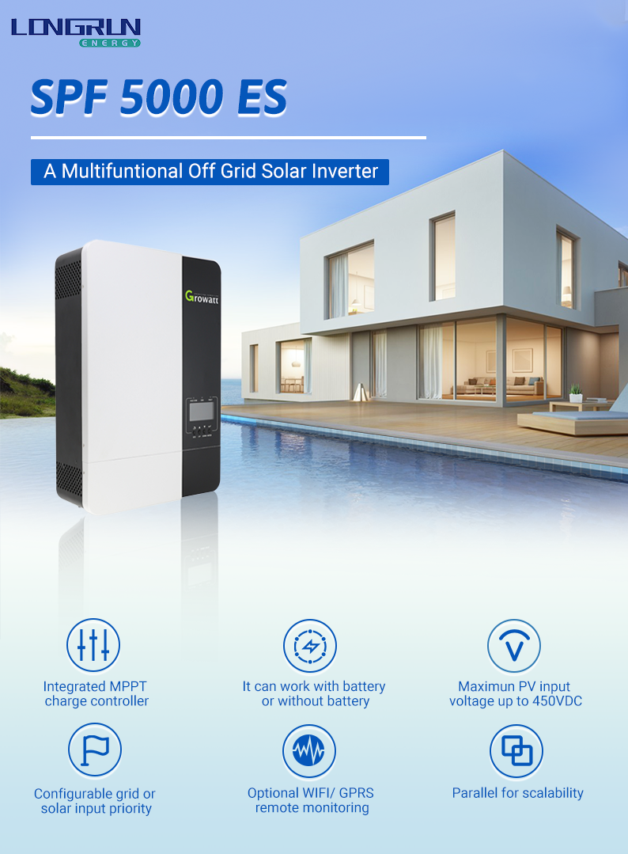
。

Slide 2
Datasheet | SPF 5000 ES
Battery voltage | 48VDC
INVERTER OUTPUT
RATED POWER | 5000VA/ 5000W
Parallel Capability | Yes, 6 units
AC Voltage Regulation (Battery Mode) | 230VAC ± 5% @ 50/60Hz
Surge Power | 10000VA
Efficiency (Peak) | 93%
Waveform | Pure sine wave
Transfer Time | 10 ms (For Personal Computers); 20 ms (For Home Appliances)
SOLAR CHARGER
Maximum PV Array Power | 5500W
MPPT Range @ Operating Voltage | 120VDC ~ 430VDC
Maximum PV Array Open Circuit Voltage | 450VDC
Maximum Solar Charge Current | 100A
Maximum Efficiency | 97%
AC CHARGER
Charge Current | 80A
AC Input Voltage | 230 VAC
Selectable Voltage Range | 170-280 VAC (For Personal Computers) ; 90-280 VAC (For Home Appliances)
Frequency Range | 50Hz/60Hz (Auto sensing)
PHYSICAL
Dimension (D/W/H) in mm | 485/330/135
Net Weight (kgs) | 12
OPERATING ENVIRONMENT
Humidity | 5% to 95% Relative Humidity(Non-condensing)
Operating Temperature | 0°C - 55°C
Storage Temperature | - 15°C - 60°C

