Slide 1
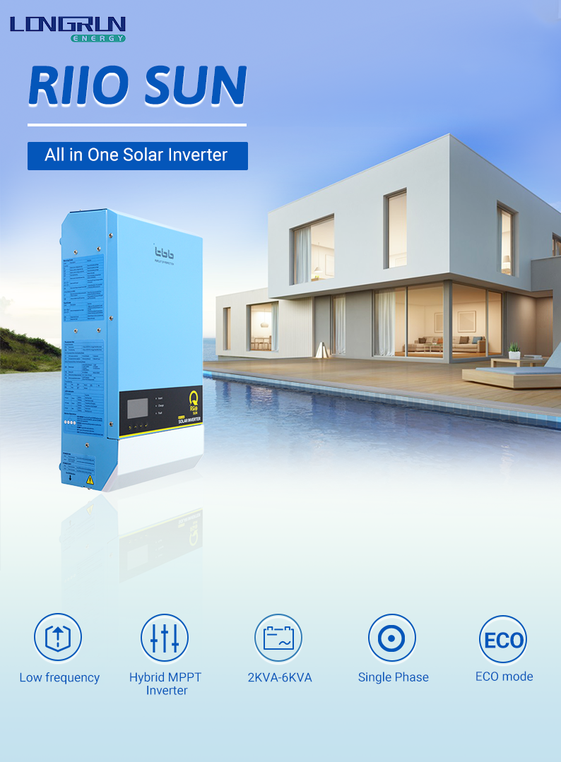

Slide 2
All in one solar inverter
Model No. | RiiOSun 2KVA-M | RiiOSun 3KVA-M | RiiOSun 2KVA-S | RiiOSun 3KVA-S | RiiOSun 4KVA-S | RiiOSun 5KVA-S | RiiOSun 6KVA-S
Model No. | RiiOSun 2KVA-M | RiiOSun 3KVA-M | RiiOSun 2KVA-S | RiiOSun 3KVA-S | RiiOSun 4KVA-S | RiiOSun 5KVA-S | RiiOSun 6KVA-S
Product Topology
Transformer based
Generator power assist
AC input range
AC input Current (transfer switch) (A)
Yes
32
175~265VAC(45~65Hz)
50
Inverter
Nominal battery voltage (V) | 24 |  | 48
Input voltage range (V) | 21~34 |  | 42~68
AC output voltage (V^C) | 220/230/240 ±2%
AC output Frequency (Hz) | 50/60 ±0.1 %
Harmonic distortion | <2%
Load Power factor | 1.0
Cont. output power at 25°C (WX) | 2000 | 3000 | 2000 | 3000 | 4000 | 5000 | 6000
Max Output power at 25°C (W) | 2000 | 3000 | 2000 | 3000 | 4000 | 5000 | 6000
Peak power (W) for 3 sec | 4000 | 6000 | 4000 | 6000 | 8000 | 10000 | 12000
Surge | 300%
Maximum efficiency | 91% | 91% | 93% | 93% | 93% | 94% | 94%
Zero load power (W) | 13 | 17 | 13 | 17 | 19 | 22 | 25
Charger
Charge voltage 'absorption' (V) | 28.8 |  | 57.6
Charge voltage 'float' (V) | 27.6 |  | 55.2
Battery types | AGM/GEL/OPZV7Lead-Carbon/Li-ion/Flooded/7raction/TBBSUPER-L
Max AC charge current (A) | 40 | 70 | 20 | 35 | 50 | 60 | 70
Temperature compensation | Yes
Solar Charge Controller
Max output current (A) | 60 | 60 | 40 | 60 | 60 | 90 | 90
Maximum PV power (W) | 2000 | 2000 | 3000 | 4000 | 4000 | 6000 | 6000
PV open circuit voltage (V) | 150
MPPT voltage range (V) | 65-145
Max. PV short circuit current (A) | 18 | 18 | 27 | 35 | 35 | 54 | 54
Charge voltage 'absorption' (V) | 28.8 |  | 57.6
Charge voltage 'float' (V) | 27.6 |  | 55.2
MPPT charger maximum efficiency | 98%
MPPT efficiency | >99.5%
Protection | a) output short circuit; b) overload; c) battery voltage too high d) battery voltage too low; e) temperature too high; f) input voltage out of range
CAN BUS Communication Port | For communication with the lithium battery
General Data
Output (AC Out) Current (A)
Transfer time
Protection
General purpose com. Port
Operating temperature range
Relative humidity in operation
Altitude (m)
 |  | 50
32
4ms (<15ms in Weak AC source Mode)
a) output short circuit; b) overload c) battery voltage too high; d) battery voltage too low
e) temperature too high; f) input voltage out of range; g) input voltage ripple too high; h) Fan block
RS485 (GPRS,WUXN optional with Kinergy)
-20°Cto65°C
95% without condensation
2000
Mechanical Data
Dimension(mm)(max) | 499x275x144
Net weight(KG) | 15 | 18 | 15 | 18 | 20 | 29 | 31
Cooling | Forced fan
Protection index | IP21
Standards
Safety | EN-IEC 62477-1, EN-IEC 62109-1, EN-IEC 62109-2
EMC | EN61000-6-1, EN61000-6-2, EN61000-6-3, EN61000-3-11 ,EN61000-3-12

