Slide 1
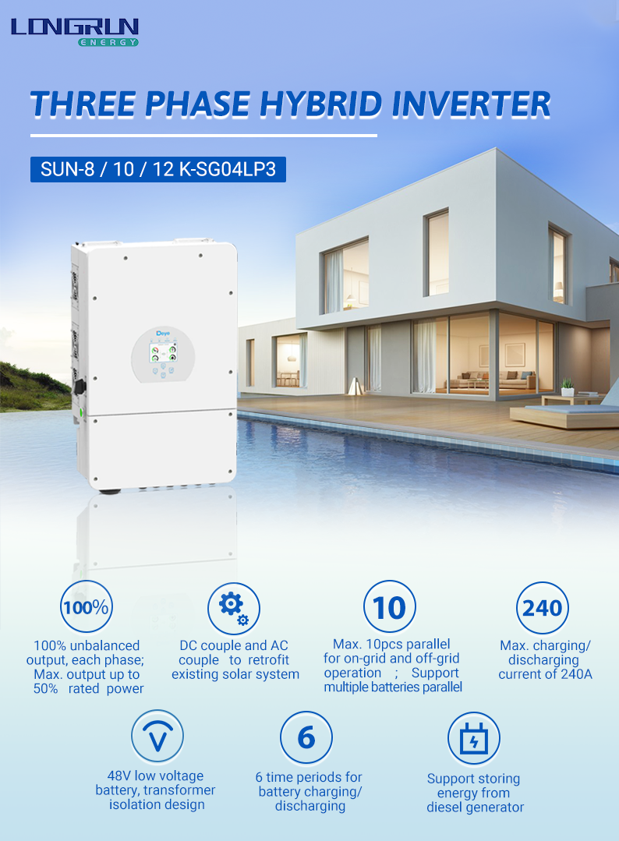

Slide 2
Technical Data www.longrun-ennergy.com
Model | SUN-5K -SG04LP3-EU | SUN-6K -SG04LP3-EU | SUN-8K -SG04LP3-EU | SUN-10K -SG04LP3-EU | SUN-12K -SG04LP3-EU
Battery Type | Lead-acid or Li-lon
Battery Voltage Range (V) |  |  | 40~60
Max. Charging Current (A) | 120 | 150 | 190 | 210 | 240
Max. Discharging Current (A) | 120 | 150 | 190 | 210 | 240
External Temperature Sensor | Yes
Charging Curve | 3 Stages / Equalization
Charging Strategy for Li-Ion Battery | Self-adaption to BMS
PV String Input Data
Max. DC Input Power (W) | 6500 | 7800 | 10400 | 13000 | 15600
Rated PV Input Voltage (V) | 550 (160~800)
Start-up Voltage (V) | 160
MPPT Voltage Range (V) | 200-650
Full Load DC Voltage Range (V) | 350-650
PV Input Current (A) | 13+13 |  |  | 26+13
Max. PV ISC(A) | 17+17 |  |  | 34+17
No.of MPP Trackers | 2
No.of Strings per MPP Tracker | 1 |  |  | 2+1
AC Output Data
Rated AC Output and UPS Power (W) | 5000 | 6000 | 8000 | 10000 | 12000
Max. AC Output Power (W) | 5500 | 6600 | 8800 | 11000 | 13200
AC Output Rated Current (A) | 7.6/7.2 | 9. 1/8.7 | 12. 1/11.6 | 15.2/14.5 | 18.2/17.4
Max. AC Current (A) | 11.4/10.9 | 13.6/13 | 18.2/17.4 | 22.7/21.7 | 27.3/26. 1
Max. Continuous AC Passthrough (A) | 45
Peak Power (oﬀ grid) | 2 time of rated power, 10 S
Power Factor | 0.8 leading to 0.8 lagging
Output Frequency and Voltage | 50/60Hz; 3L/N/PE 220/380, 230/400Vac
Grid Type | Three Phase
Total Harmonic Distortion (THD) | <3% (of nominal power)
DC current injection | <0.5% In
Eﬃciency
Max. Eﬃciency | 97.60%
Euro Eﬃciency | 97.00%
MPPT Eﬃciency | 99.90%
Protection
Integrated | PV Input Lightning Protection, Anti-islanding Protection, PV String Input Reverse Polarity Protection, Insulation Resistor Detection, Residual Current Monitoring Unit, Output Over Current Protection, Output Shorted Protection, Surge protection
Output Over Voltage Protection | DC Type II/AC Type III
Certiﬁcations and Standards
Grid Regulation | VDE4105, IEC61727/62116, VDE0126, AS4777.2, CEI 0 21, EN50549- 1, G98, G99, C10- 11, UNE217002, NBR16149/NBR16150
Safety EMC / Standard | IEC/EN 61000-6- 1/2/3/4, IEC/EN 62109- 1, IEC/EN 62109-2
General Data
Operating Temperature Range (C) | -40~60C, >45C derating
Cooling | Smart cooling
Noise (dB) | <45 dB
Communication with BMS | RS485; CAN
Weight (kg) | 33.6
Size (mm) | 422W x 699.3H x279D
Protection Degree | IP65
Installation Style | Wall-mounted
Warranty | 5 years
Battery Input Data

