Slide 1
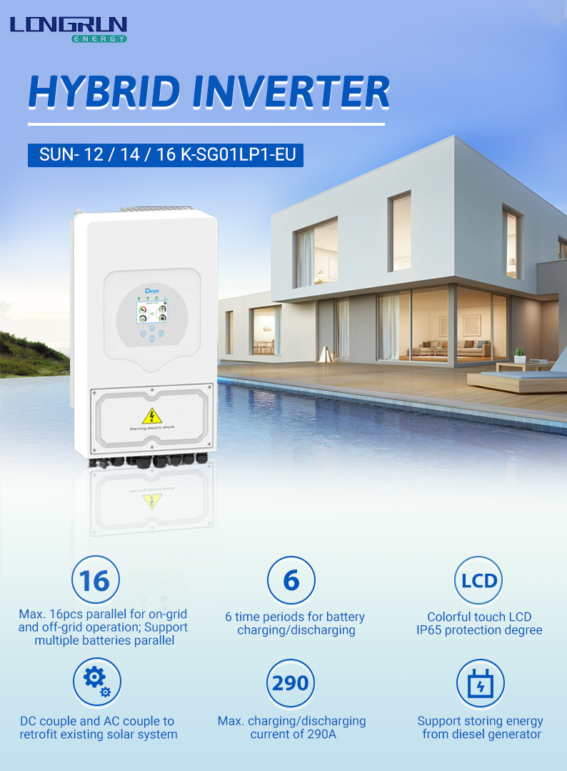
This is currently the most popular hybrid inverter in the Eropean market, he can be connected to the grid operation, or not connected to the grid operation. With six charging and discharging period, it can also accept the energy stored by a diesel generator t keep your home powered for 24 hours a day.

Slide 2
Model SUN-12K-SG01LP1-EU SUN-14K-SG01LP1-EU SUN-16K-SG01LP1-EU
BatteryType | Lead-acid or Li-lon
Battery Voltage Range (V) | 40~60
Max. Charging Current (A) | 220 | 250 | 290
Max. Discharging Current (A) | 220 | 250 | 290
External Temperature Sensor | Yes
Charging Curve | 3 Stages / Equalization
Charging Strategy for Li-Ion Battery | Self-adaption to BMS
PV String Input Data
Max. DC Input Power (W) | 15600 | 18200 | 20800
Max. DC Input Voltage (V) | 500
Start-up Voltage (V) | 125
MPPT Range (V) | 150-425
Rated DC Input Voltage (V) | 370
PV Input Current (A) | 26+26+26
Max. PV I_{SC}(A) | 44+44+44
No.of MPP Trackers | 3
No.of Strings per MPP TrackerAC Output DataRated AC OutputPower (W) | 2
 | 12000 | 14000 | 16000
AC Output Rated Current (A) | 54.5/52.2 | 63.6/60.9 | 72.7/69.6
Max. Continuous AC Passthrough (A) | 100
Peak Power (off grid) | 2 time of rated power, 5 S
Power Factor | 0.8 leading to 0.8 lagging
Output Frequency and Voltage | 50/60Hz; L/N/PE 220/230Vac (single phase)
Grid Type | Single Phase
DC injection current (mA) | <0.5%1n
Backup Data
Backup Power (W) | 10000 | 12000 | 14000
Backup Rated Current (A) | 45.5/43.5 | 54.5/52.2 | 63.6/60.9
Backup UPSEfficiencyMax. Efficiency | 6ms Automatic switchover time 97.60%
Euro Efficiency | 96.50%
MPPT Efficiency Integrated | 99.90% PVInputLightningProtection,Anti-islandingProtection,PVStringInputReversePolarityProtection, InsulationResistorDetection,ResidualCurrentMonitoringUnit,OutputOverCurrentProtection, OutputShortedProtection,Surgeprotection
Output Over Voltage ProtectionCertifications and StandardsGrid Regulation | DC Type II/AC Type III CEI 0-21, VDE-AR-N 4105, NRS 097, IEC 62116, IEC 61727, G99, G98,VDE 0126-1-1, RD 1699, C10-11
Safety EMC / StandardGeneral DataOperating Temperature Range (℃) | IEC/EN 61000-6-1/2/3/4, IEC/EN 62109-1, IEC/EN 62109-2 -40~60℃, >45℃ derating
Cooling | Smart cooling
Noise (dB) | <30 dB
Communication with BMS | RS485; CAN
Weight (kg) | 48.5
Size (mm) | 464W×798.4H×300D
Protection Degree | IP65
Installation Style | Wall-mounted
WarrantyFeatures | 5 years

